Slide 1
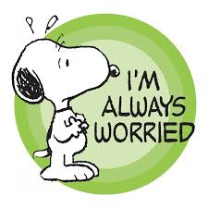
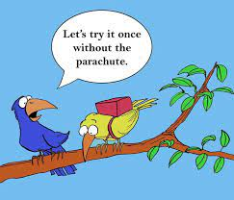
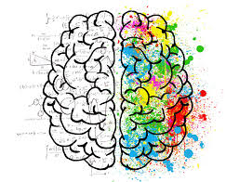
THE WORRIED GENERATION WHY ADOLESCENTS ‘FEEL ANXIOUS ABOUT BEING ANXIOUS’ AND WHAT CAN HELP
SOPHIA DAVISON – CHILD AND ADOLESCENT PSYCHOTHERAPIST

Slide 2
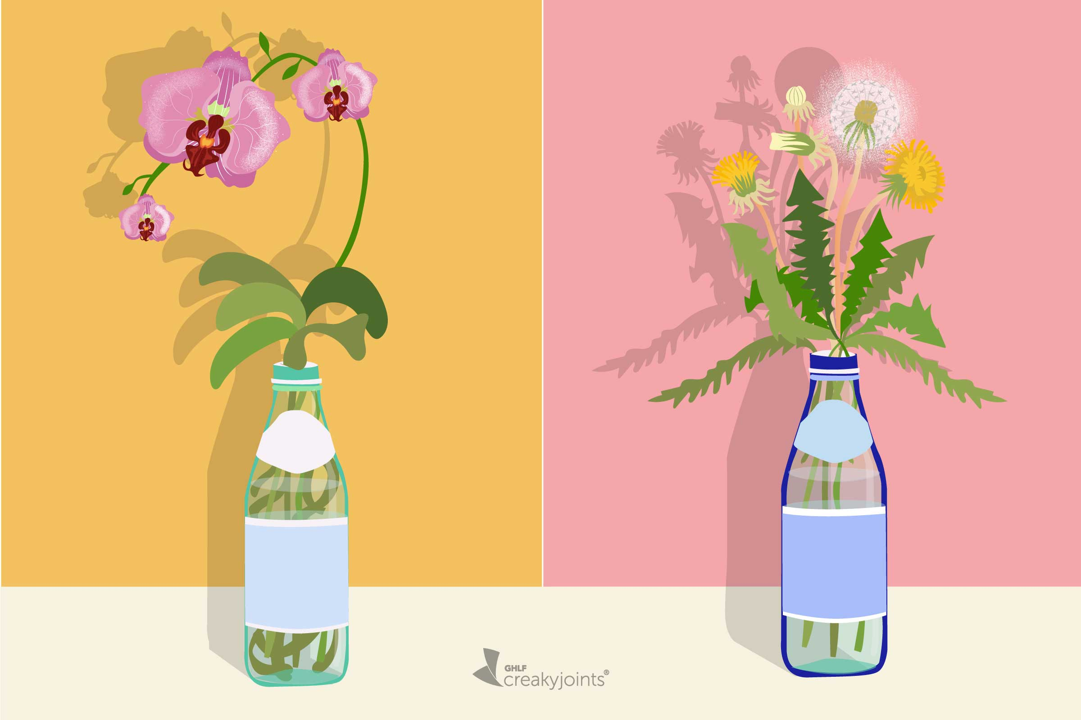
Scope of the session
Are children more anxious today and, if so, why?
Causes of anxiety, including the biology of stress.
The metaphor of the orchid and the dandelion
Anxiety can be positive: why we need to embrace it sometimes.
What to do when anxiety is crippling – practical suggestions.

Slide 3
are adolescents more anxious than we were?
The world faces existential challenges – Covid, climate change and global conflict have impacted everyone, especially young people.
Jonathan Haidt ‘s book The Anxious Generation argues that “the rewiring of childhood” has contributed to a mental health epidemic for teens.
He blames impact of screens and social media coupled with overprotective parenting.
In the 1990s and early 2000s mental health data is relatively stable.
But in 2012 we began to see a significant increase in anxiety, depression and self-harm.
What changed?

Slide 4
A TECHNOLOGY REVOLUTION
What was your technology life like in 2010?
Technology at this point was a tool for planning face to face connecting.
By 2015 most teenagers in the western world had smart phones with forward facing cameras which often enabled the worst aspects of being a teenager to be amplified.
Most young people tell us that social media makes them feel closer to their friends
BUT

Slide 6
Some of the reasons why children worry
Genetic predisposition, although there isn’t a single anxiety gene
Modelling from family
Existential state of the world
Their imaginations
Being more inclined to rigidity – requiring predictability and perfectionism
It is useful at times

Slide 7
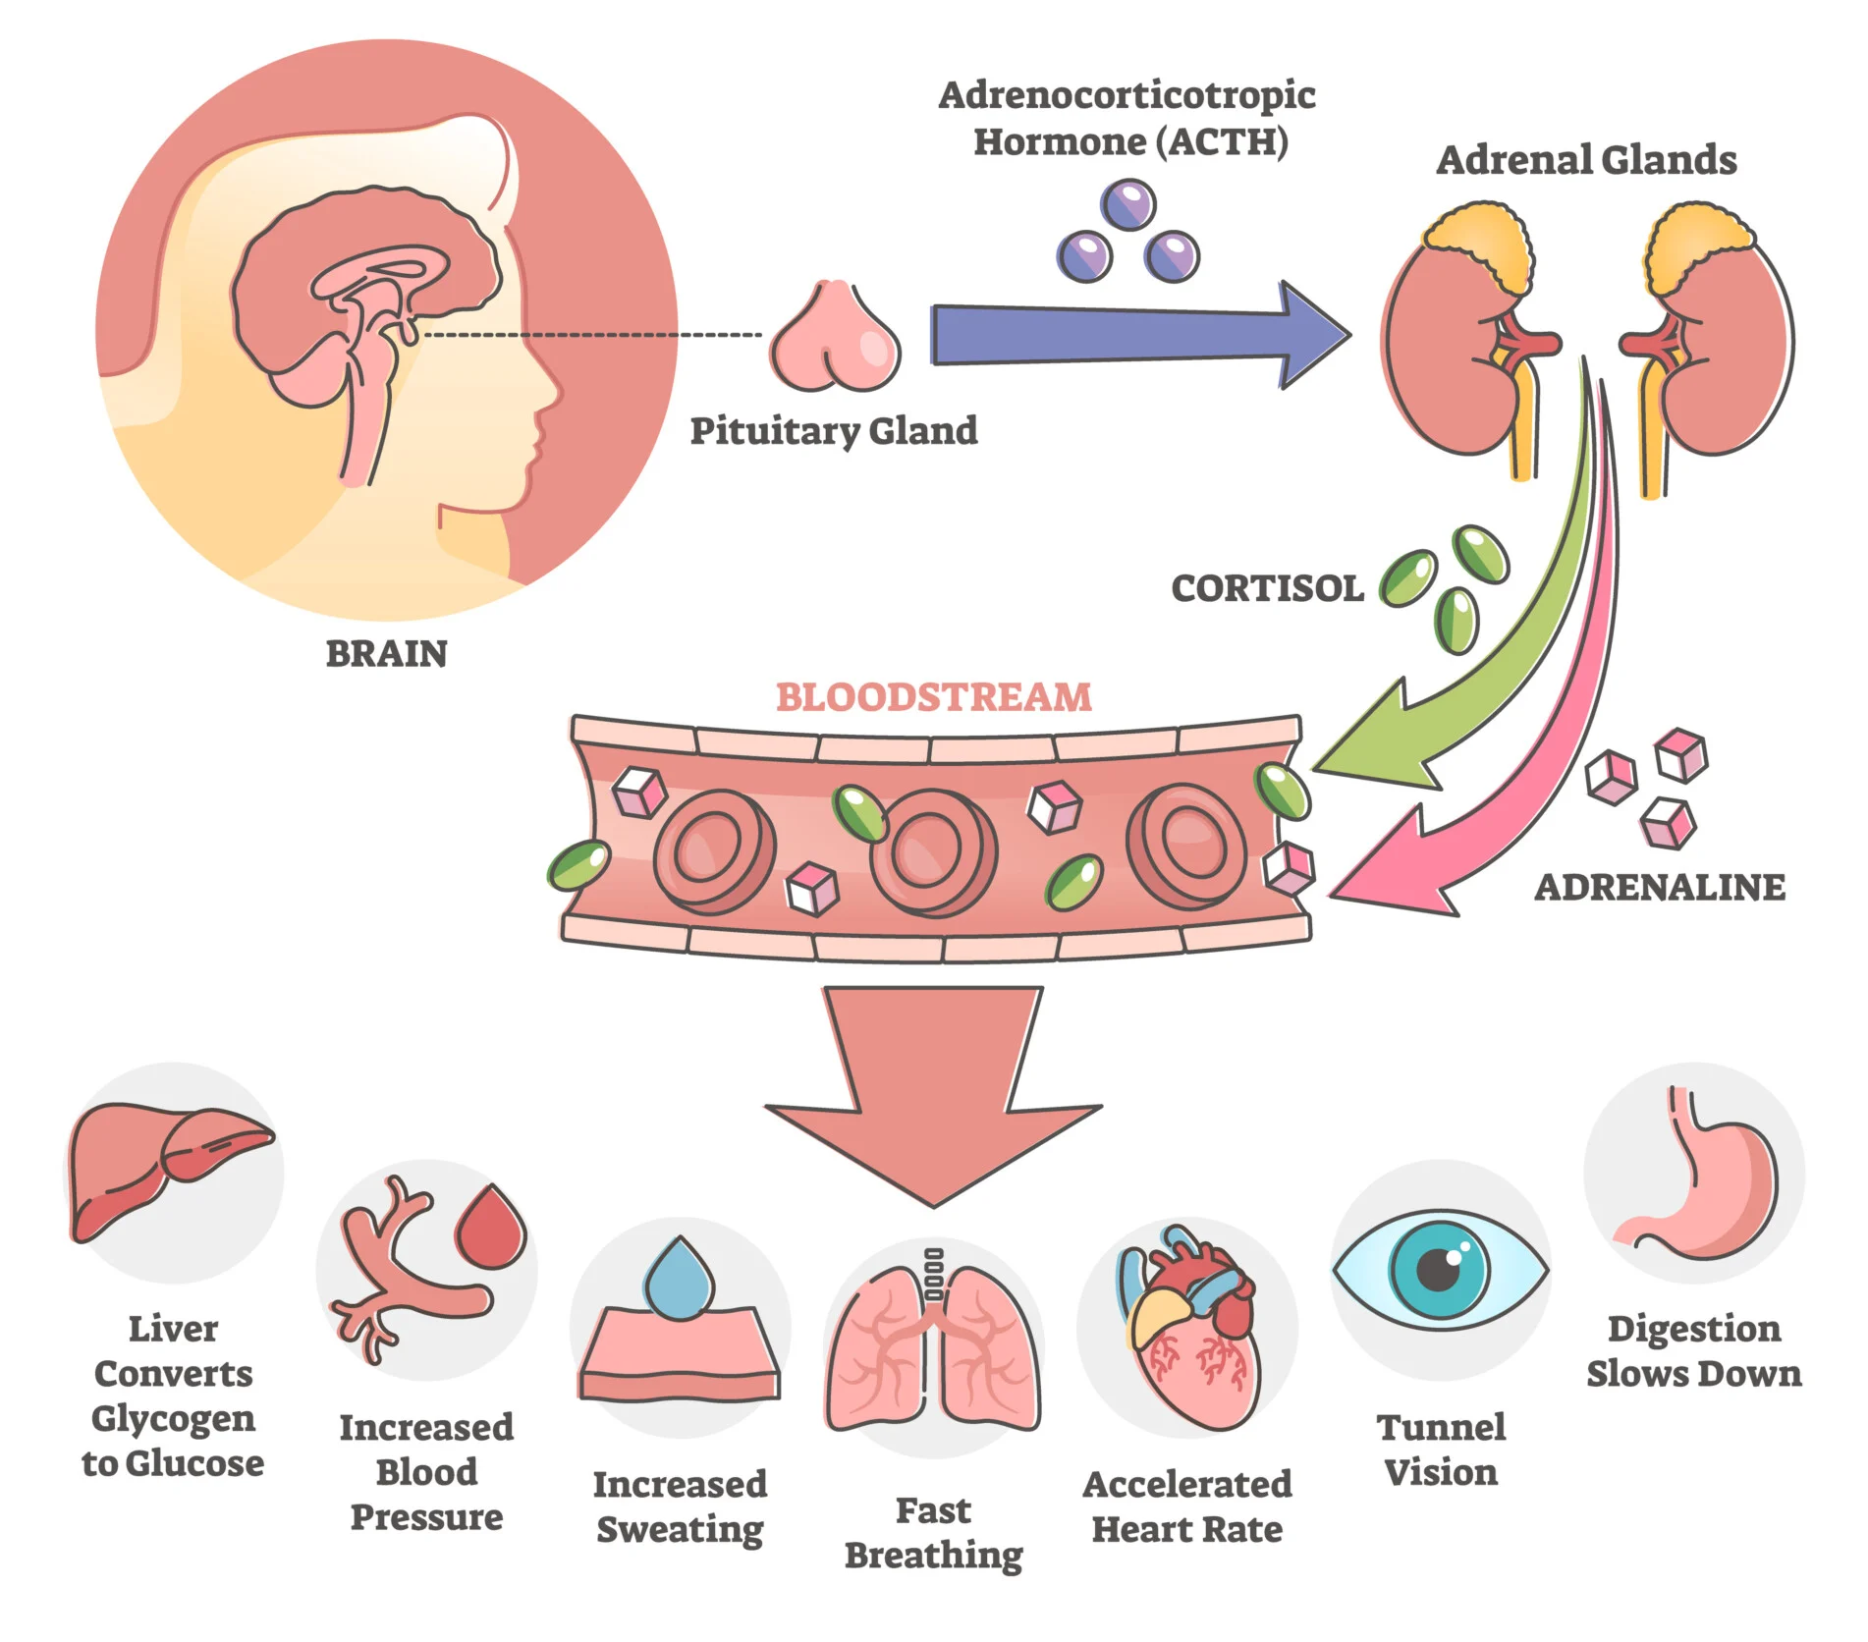
The biology of stress
We have 2 stress response systems:
1:the cortisol system which releases cortisol into the bloodstream, filling the body with stress chemicals
2: the fight or flight system which causes physical symptoms such as increasing our heart rate
These two stress response systems work together; activation in one system tends to lead to activation in the other.

Slide 8
The value of feeling anxious learning to be comfortable with being uncomfortable
Anxiety is inevitable when we operate at the edge of our abilities.
When people are having an anxious reaction out of proportion to the actual situation their thinking is usually off-track in two ways:
they are over-estimating how bad the situation really is and
under-estimating their ability to deal with.
It helps to see worry as a powerful part which protects us when we need it.
This strategy of valuing the worry and anxiety process reinforces understanding that we all feel anxious points.
How much children are impacted by anxiety may depend on how they think about worry.
How they regard stress has a powerful effect: those with a “stress-is-enhancing” outlook outperform those with a “stress-is-debilitating” one.
Seeing stress as useful changes how the body operates under pressure.

Slide 9
What happens in the body when we are anxious?
Normal, healthy life-saving changes that occur in the body when our brain communicates with our autonomic nervous system:
Blood sugar levels increase
Pupils dilate
Sweat glands perspire
Heart rate increases
Muscles tense
Exaggerated fight / flight response:
The heart skips a beat or beats irregularly
Stomach feels tied in knots
Hand arms or legs shake
They have difficulty catching their breath
Their mouth becomes dry
They might have difficulty swallowing
They feel clammy, sweaty

Slide 10
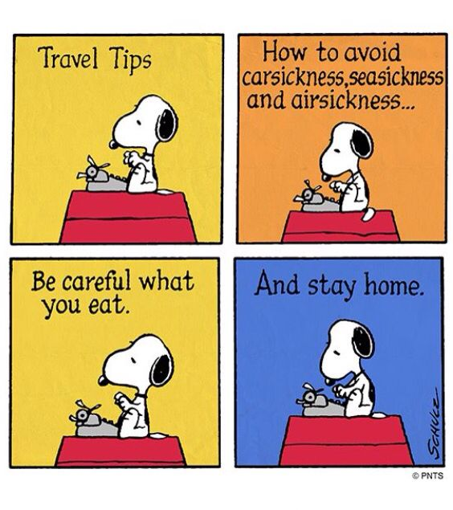
Anxiety is essentially a method of seeking certainty and comfort. The problem is that it wants these outcomes immediately
Fear, uncertainty, worry these are all normal and expected parts of life
Anxious children don’t see these feelings as normal. They mistake them as powerful signals to stop and avoid.
Avoidance usually makes things worse. It is action rather than avoidance that helps.

Slide 11
EASY MISTAKES TO MAKE
Colluding
Colluding with avoidance
Rescuing
Rescuing, reassuring
Certainty
Certainty providing
Making more accommodations for anxiety
Tolerating
Tolerating bad behaviour because someone is feeling anxious
Modelling
Modelling our own anxious behaviour
Accommodating

Slide 12
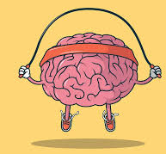
Change your mindset
Normalise the full range of adolescent emotion.
Spectrum from the most pleasant to least is an expectable and essential.
Don’t mistake extreme emotional intensity for psychological fragility. They can be dramatic!
Be matter of fact, expect worry will show up, encourage them to recognise the signs in their body that they’re anxious.
Maintain an overriding belief they can handle the experience and hang in there.
Imagining the worst-case scenario, whilst it can’t change an unwanted situation, can change how adolescents think about it.
Instead of focusing help on our teens becoming happy about the situation, help them become more realistic about it.
Build the capacity to observe feelings dispassionately.
Expose children to countless opportunities to succeed and fail.
Have a counterbalance of sameness and routine at home to offset the anxiety that can accompany new things .

Slide 13
Challenge ‘I have anxiety’ chat
Being an adolescent is partly about constructing an identity, getting a sense of who you are.
If you start to hear them say things like “I have anxiety” don’t let it become their organising identity because it is limiting.
Everybody experiences anxiety.
Watch out for self-diagnosing in teenagers.
Distinguish between healthy nervousness and an anxiety disorder.

Slide 14
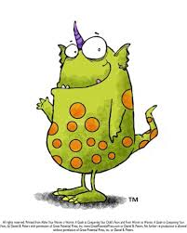
Resist reassuring
I’ll use 2 tactics to keep parents stuck as explainers and fixers:
I’ll ask repetitive questions to seek certainty and comfort
2) I’ll pull you into a content trap to get you to focus on a specific event

Slide 15
A new approach
Accept anxiety don’t deny it
Hear worry don’t obey it
Get them to talk more and you talk less
Use reminder bridges to recall past successes
Ask them:
‘Is this a thought or a fact?”
Ask yourself: am I promoting independence or dependence?.
Distraction is your friend

Slide 16
Calm breath exercise
Breathe out all the way.
Take a deep breath and let your belly expand first and then your chest.
Slowly exhale saying ‘calm’ or ‘relax’ under your breath. Keep it a simple word.
Let your muscles go limp and warm, loosen your face and jaw muscles.
Remain in this resting position for a few more seconds without thinking about your breathing or anything else.

Slide 17
Final thoughts
Mental health is not about feeling good.
It is about having the right feelings at the right time and being able to manage those feelings effectively.
We can be confident in their overall emotional health so long as:
They have feelings that make sense in light of their circumstances
They find adaptive ways to manage those emotions - hold themselves together quite ably at school and then at home can finally let themselves fall apart.
Rely on a range of defences that offer relief without distorting reality – circuit breakers to ease emotional discomfort.
And for those of you who have children who are struggling with prolonged anxiety please remind them that it is not a permanent state.
There are many good ways of treating crippling anxiety; it doesn’t mean you’ll never feel anxious again, anxious feelings are part of life, but debilitating anxiety does not need to define us and young people need to be reminded of that.

Slide 18
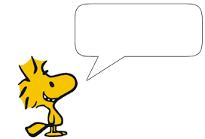
USE PACE in conversations
PLAYFUL
ACCEPTING
CURIOUS
EMPATHIC

Slide 19
Express Interest
Reflect Back
Elaborate
Be Curious
Sounding Board
Ideas not Instruction
Empathy
Confidence Boost

