Slide 1
SEND & Inclusion June 2024 Parents Forum

Slide 2
Schedule
Overview of staff structure
Guidance on adaptive teaching and TA support in lessons – and how you might be able to use same strategies at home
How we assess, plan, support and review students with SEND
Q&A

Slide 3
Staff structure
Head of SEND & Inclusion
Deputy SENCO (Upper based)
Learning Mentor team
X 2
Counselling team:
Sophia, Phaedra & Tracey
SEND Administrator
(inc. Access Arrangements) Ms Townley
Lead Practitioners:
Cognition and Learning - Mrs Machlarz
Autism & SLCN - Mrs Gundelach
SEMH – Mrs Khan
SEND – Ms Kader
EAL – Mr White
HLTA Autism – Mr Whybrow
Maths - vacant
TA team
Mr Melillo – English
Ms Arribas - Science
Ms Lahmandhaz – Maths
Ms Fabian - year 7

Slide 4
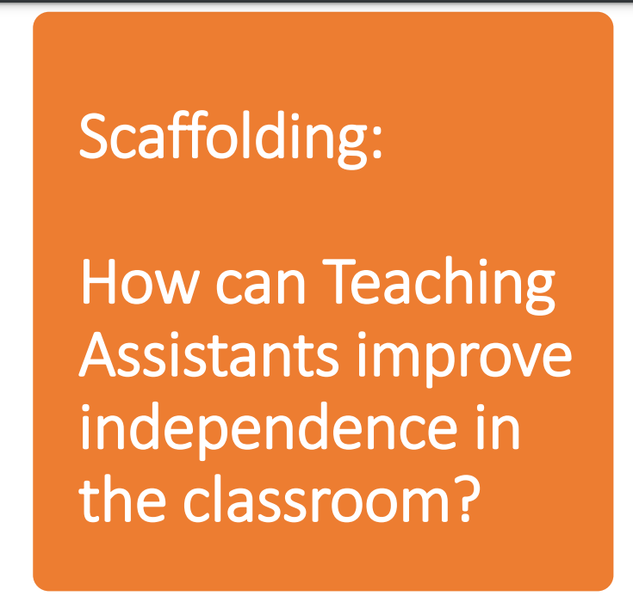

Slide 6
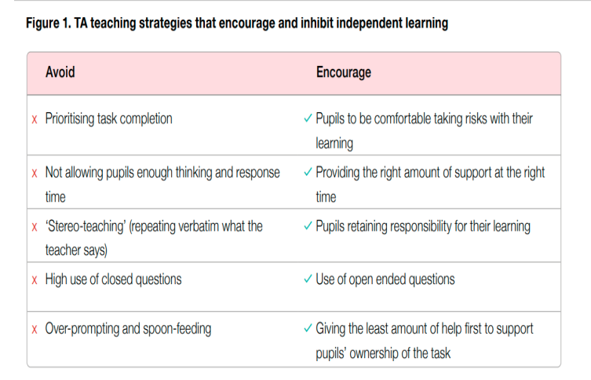

Slide 9
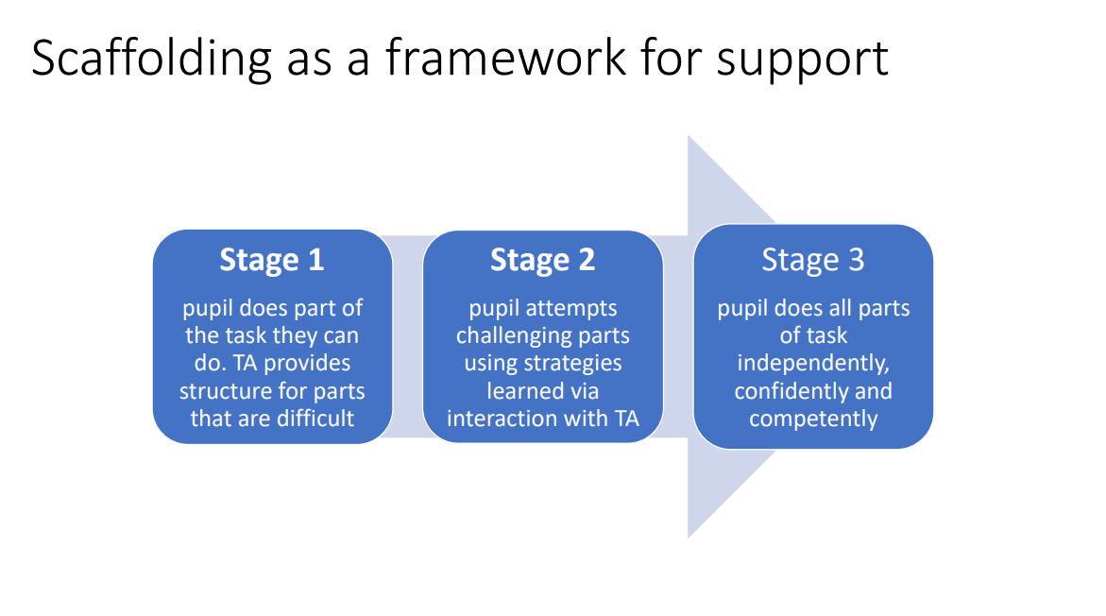

Slide 10
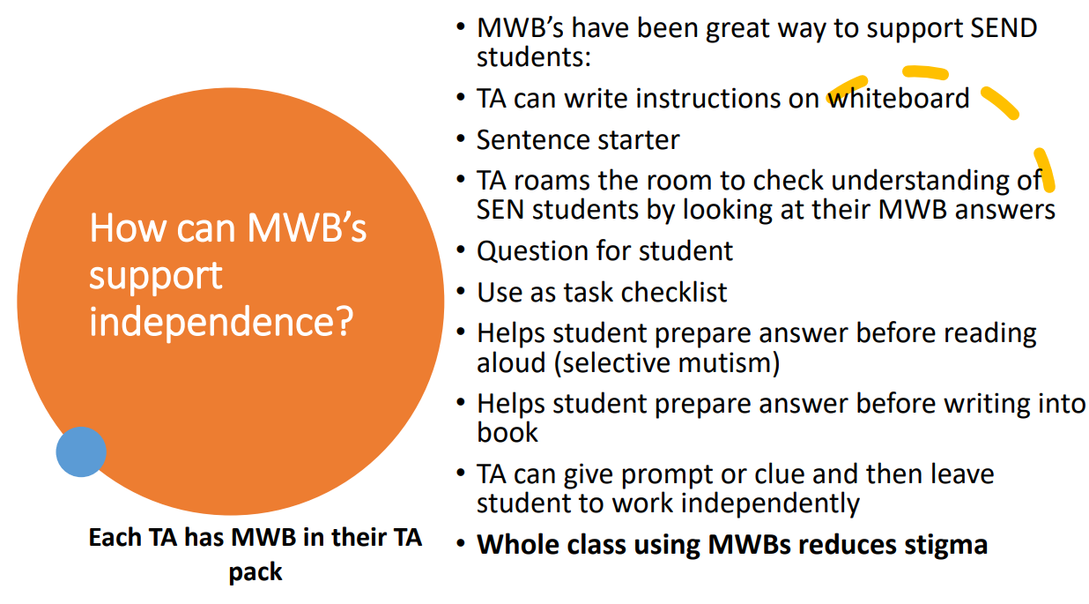

Slide 13
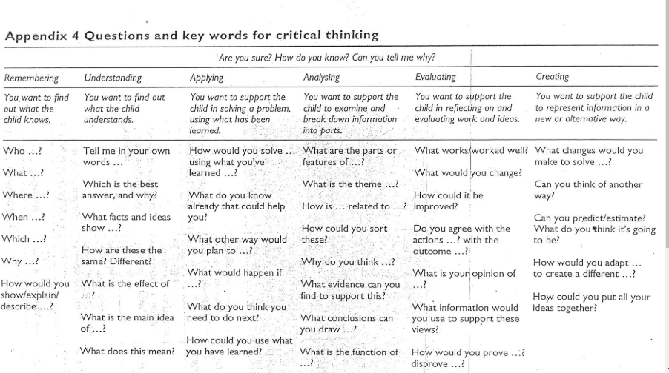

Slide 14
Early identification and assessment​

Slide 15
Source of cause for concern
Next steps
Review and assessment
Outcome
Student arrives with EHCP or identified SEN Need
KW allocated and SEN Support Plan generated. Plan is reviewed at least 3/year
Student has needs that require targeted support and intervention outside of the classroom.
Student identified through academic monitoring
Student requires targeted but time-limited intervention to build skill, e.g., touch-typing, Lexia. Intervention logged for outcome monitoring.
HOY collates information from range of teachers, including assessment of need forms and refers to SEN via Cause for Concern form
SEN team review C4C and AoN at SEND Panel.
Complete observation in lesson x 2, plus complete one or more relevant assessments.
Student identified through pastoral monitoring
Students needs can be met through universal level, personalised learning. Profile generated with 5/6 personalised strategies for teachers and wider support staff.
Parent raises concern through LRD, etc
Referred to form tutor to collate concerns and offer initial, universal advice
Students’ results monitored at next EG data drop.

Slide 16
Outcome
Next steps
Review
Student has needs that require targeted support and intervention outside of the classroom.
Allocate keyworker, based on area of need, and develop a learning plan.
Student making progress:
Stay on SEND Support
Student not making progress or provision is beyond 'ordinarily available'.
Make application for EHCP assessment.
Make referral for specialist assessment:
Educational Psychologist
IAT
Autism Advisory team
Incorporate into LP.

Slide 17
Q&A

