Slide 1
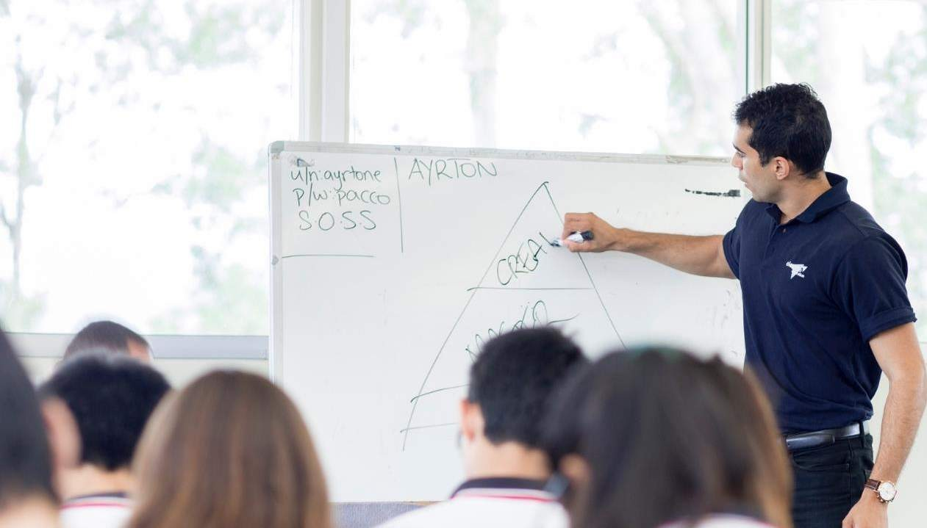

Parent Seminar

Slide 2















Elevate Education – Who are we?
Research: Why do the top students get the top results?
Work with the top students around the world (2000+ schools,
across 5 countries)
13 key study habits

Slide 3

13 key skills
Belief
Stress
Goals
Post
Exam
Environment
Memory skills
Team
Success
Exam preparation
Results oriented
Practice questions/mock exams
Organization skills
Independent work
Use of holidays

Slide 4
Elevate Parent Seminar
Time Management

Slide 5








Elevate Education – Study Timetables
What?
When?
Sport
What?
When?
Social
What?
When?
Hobbies
What?
When?
TV
What?
When?
Job

Slide 6
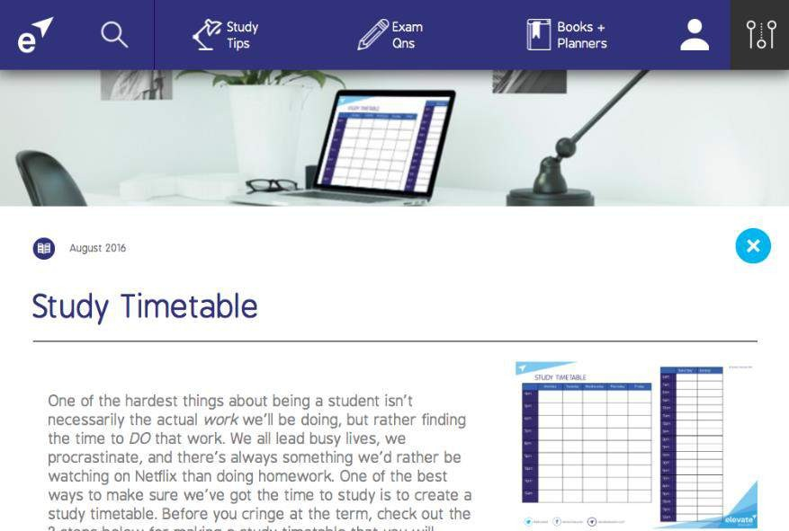
Elevate Education – Study Timetables
 | MONDAY | TUESDAY | WEDNESDAY | THURSDAY | FRIDAY | SATURDAY | SUNDAY
7:00 |  |  |  |  |  |  | Sleep in
8:00 | School
9:00
10:00 |  |  |  |  |  | Basketball
11:00
12:00
1:00
2:00
3:00
4:00 |  | Swimming |  | Swimming
5:00 |  |  | Guitar lesson |  | McDonalds
6:00 |  |  |  |  |  | Party
7:00
8:00 | Netflix
9:00 |  |  | Netflix
10:00
11:00
12:00

Slide 7
Elevate Parent Seminar
Motivation

Slide 8
Hierarchy of Motivation
Goal Clarity
Fully
Motivated
www.discoveruni.org.uk www.ucas.com www.notgoingtouni.co.uk
Largely Motivated
Flat liners
Unmotivated

Slide 9
Setting a goal
Step 1: Consider options and write down what you want to do
Step 2: Determine entrance requirements Step 3: Account for rising entrance scores Step 4: Write the goal down & make it visual

Slide 10
Elevate Parent Seminar
What to do

Slide 11
3 types of work
Practice Papers
Making notes during term
Extra reading
[literary analyses, in depth facts, alternative arguments, quotes]

Slide 12
Elevate Parent Seminar
Dealing with Technology

Slide 13
Dealing with tech
Controlling behaviour → self-regulating behaviour
  High powered vs low powered work

Slide 14
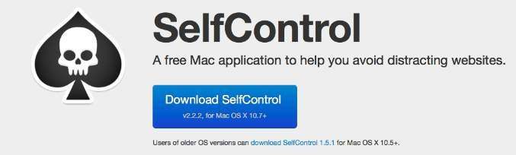
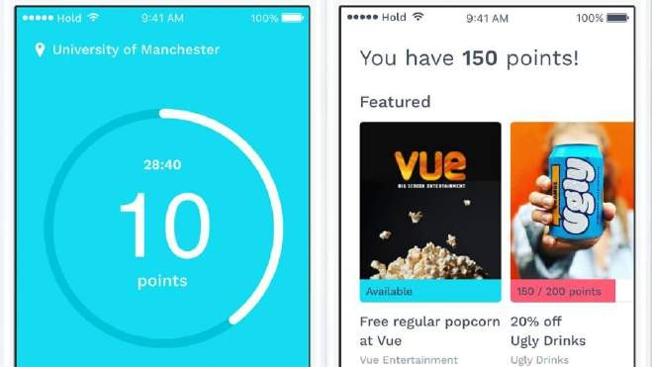


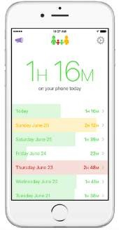
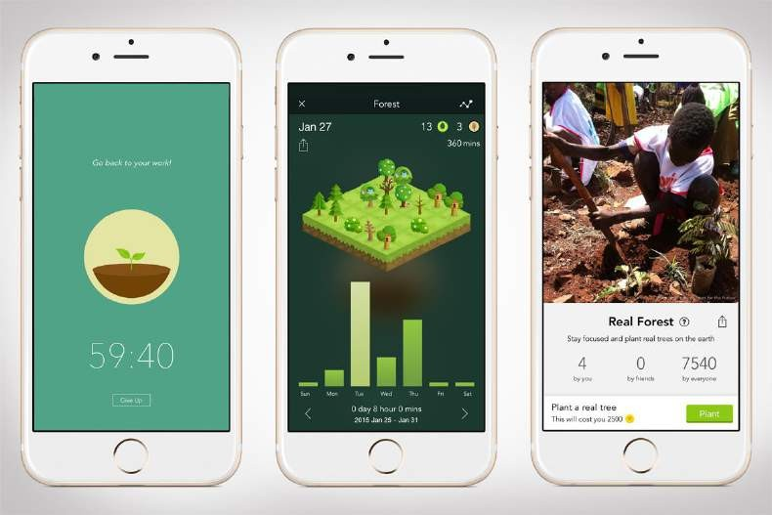

Dealing with tech
Hold

Slide 15
rondo

Slide 16


Next steps you can take

Slide 17

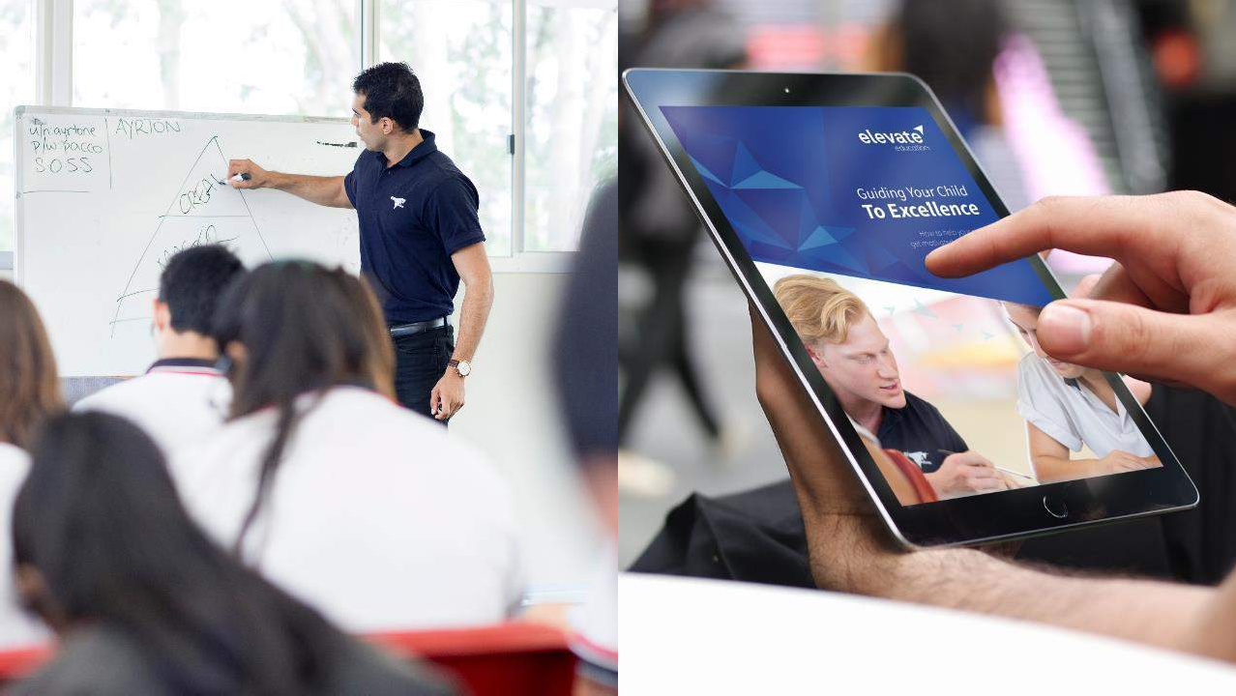
Parent Guidebook
How to help your child to get motivated, manage stress and excel in exams
CLICK HERE

Slide 18




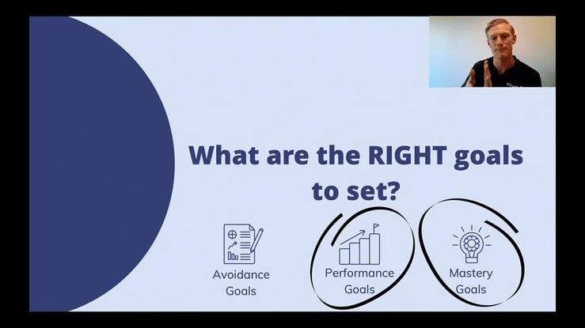
Parent Webinars
Topic-Specific | Live Q&A

Slide 19
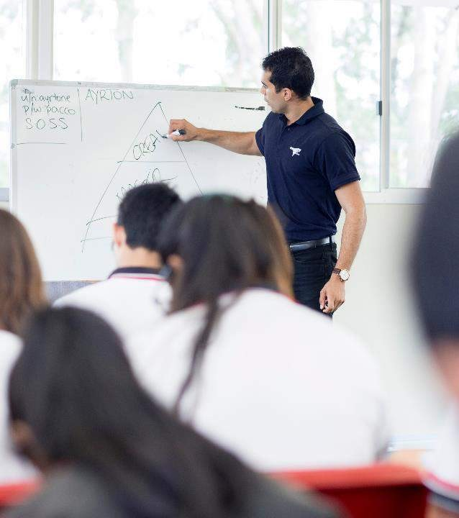


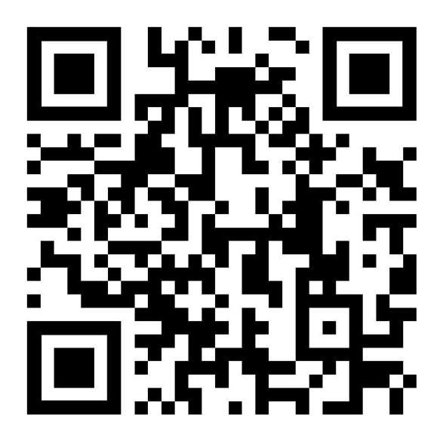
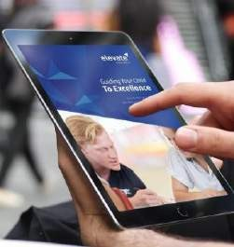
Scan QR
PARENT WEBINARS
PARENT GUIDEBOOK

