Slide 1
SEND & Inclusion Spring 2024 Parents Forum

Slide 2
Schedule
Dr Emma Sagzan, Barnet Educational Psychology Service 'The role of Education Psychologist in schools'
Upcoming calendar of events
Q&A

Slide 3
Educational Psychologists
At Archer Academy
Dr Emma Sagzan
Barnet Educational Psychology Service

Slide 4
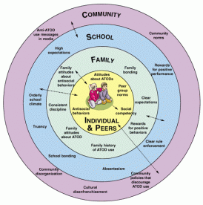
What is an EP
a professional who applies psychological research and theory to community settings (particularly schools) aiming to remove any barrier to inclusion
A hollistic practitioner
Cognition & Learning
Communication & Interaction
Social, Emotional and Mental Health
Sensory and physical

Slide 5
Working a different levels
Whole school
e.g. training, policy/provision development
Group
e.g. consultation or intervention for looked after children, LGBTQ+ students, year 9.
Reflective spaces or workshops for identified staff or parents
Individual
home/school consultation
observation and assessment when required
direct intervention
multi-disciplinary meetings

Slide 6
Accessing EP support at Archer
At a school wide level
Graduated approach
As part of the EHCP process

Slide 7
What to expect from EP involvement
Collabrative and non-judgemental approach
Consultation (further work if required)
Needs rather than diagnostic led.
Areas to be explored
strengths, interests, challenges, what is working well, what is not working, hopes and expectations for the future, next steps

Slide 8
Upcoming Events
18-22 March – Neurodiversity Week
Neurodiversity Book Club
Neurodiverse Student Forum
Neurodiverse Fact File
Form time presentations
Tuesday 23 April – SEND Parent Forum – welcoming new parents
Monday 17 June – SEND Parent Forum – Launch of Parent Survey and feedback

Slide 9
Q&A

