Slide 1
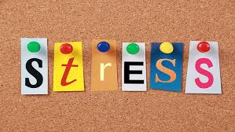
Navigating life during exam time
Developmental considerations and practical tips for supporting teenagers
Sophia Davison
Child and Adolescent Psychotherapist

Slide 2
Scope of the session
Stress
Anxiety
Practical strategies
Perfectionism
Procrastination
Learning Styles
Memory
Revision strategy

Slide 3
STRESS – HOW TO HELP TEENAGERS EMBRACE IT
Stress is an inevitable part of exams
The role of mindset in managing stress
Learning to be comfortable with being uncomfortable

Slide 4
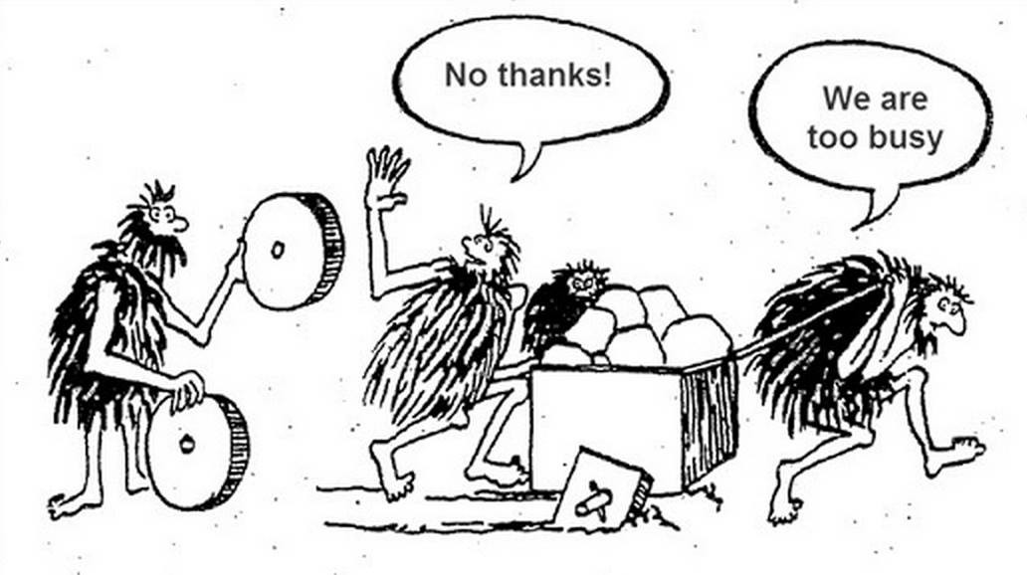
ATTACKING ANXIETY – HOW TO EASE CONCERNS
Supporting teenagers to get out of their own way
Expressive writing and the practice of values affirmation
Challenging stereotypes

Slide 5
STRATEGIES FOR MANAGING ANXIETY
Worst case scenario
Observe feelings dispassionately
Immerse yourself in music
The gift of perspective
Personalise
Parts of Self
Movement addresses adrenaline

Slide 6
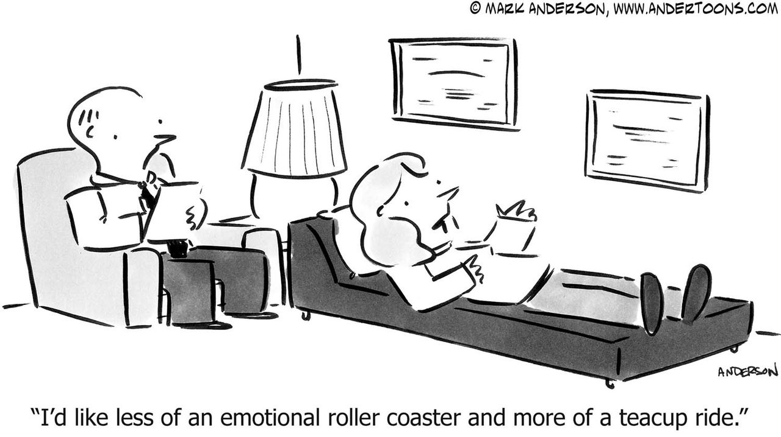
STRATEGIES TO HELP TEENAGERS REGAIN EMOTIONAL CONTROL

Slide 7
Normalise the full range of emotions
Mental health is not about feeling good
Distraction is your friend
Worry Time can help
Tiny treats make a big difference

Slide 8
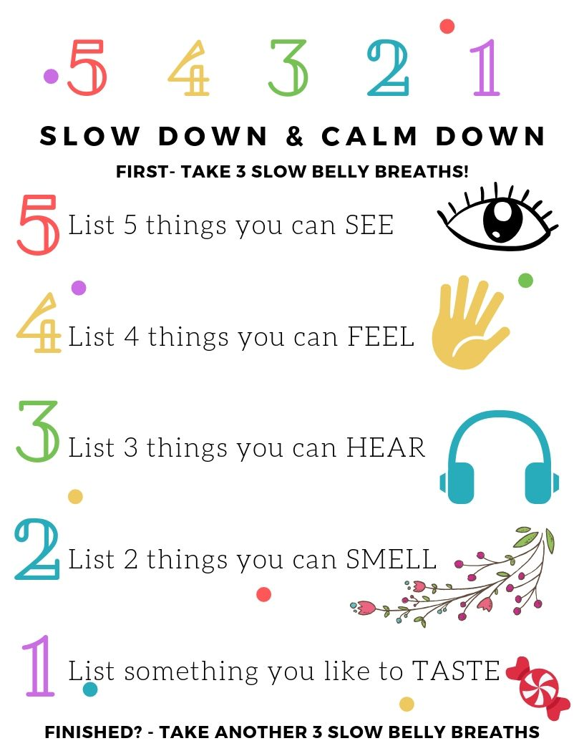

Slide 10
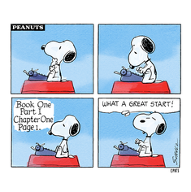
Procrastination
Humans love avoiding hard things
Put the responsibility on them
“The whole family is doing GCSEs”
Procrastination is often a consequence of not revising in the right way

Slide 11
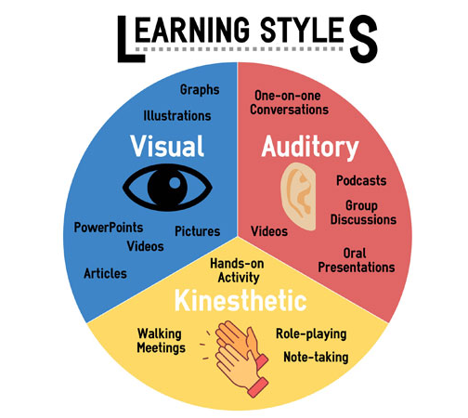

Slide 12
The role of Memory
Tests don’t recognise
Space rather than cram
Effort not flow
Practice output not input

Slide 13
perfectionism
Empathy
Self-reflection
Encouragement
Dialogue

Slide 14
Managing results day
Talk about how they want to manage this process
If results are not what they wanted stay calm and be empathic
GCSEs are one measure of success – failing exams does not make you a failure

Slide 15
Flora is a productivity app that locks your phone and blocks other apps according to a timer you set. During the time your phone is blocked, you will plant a virtual tree. you can set a joint timer with friends so you can both stay focused and plant trees together. You can also share the progress of your virtual garden and encourage each other to stay motivated. Memrise can be a valuable resource for language learners. Its focus on vocabulary acquisition, with a spaced repetition system, can help students expand their vocabulary and improve their language skills. Quizlet allows you create different sets of flashcards that you can study on repeat and shuffle modes.

Slide 16
Listen without interrupting
Offer sincere empathy – avoid “at least”
Validate distress
Support coping
“Is there anything I can do that will make this worse?”
Express non-dismissive confidence
“This is tough, and so are you.” or
“As hard as this feels right now, I
do think that you’ll get through it.”
Use PACE: Playful, Accepting, Curious, Empathic
Offer to help problem-solve
“Do you want my help trying to
tackle this?”
Divide the problem into two lists
Things that can be changed and things
that can’t.
For the things that can be changed,
brainstorm possible solutions
For what cannot be changed,
support acceptance

