Slide 1
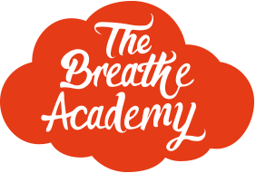
How to be a calmer, kinder parent and carer
Jo Kaye
Mindfulness Coach

Slide 2
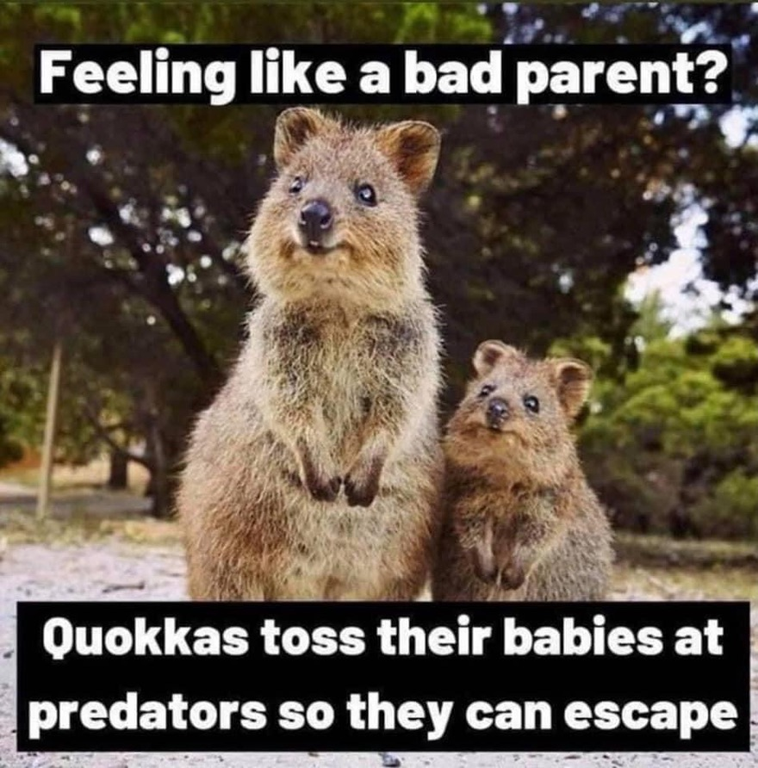

Slide 3
What this session is NOT going to be about
How to be the perfect parent
How to have the perfect child
How to be calm and zen all the time
How to have the perfect family who never argue and spend all day smiling at each other….

Slide 4
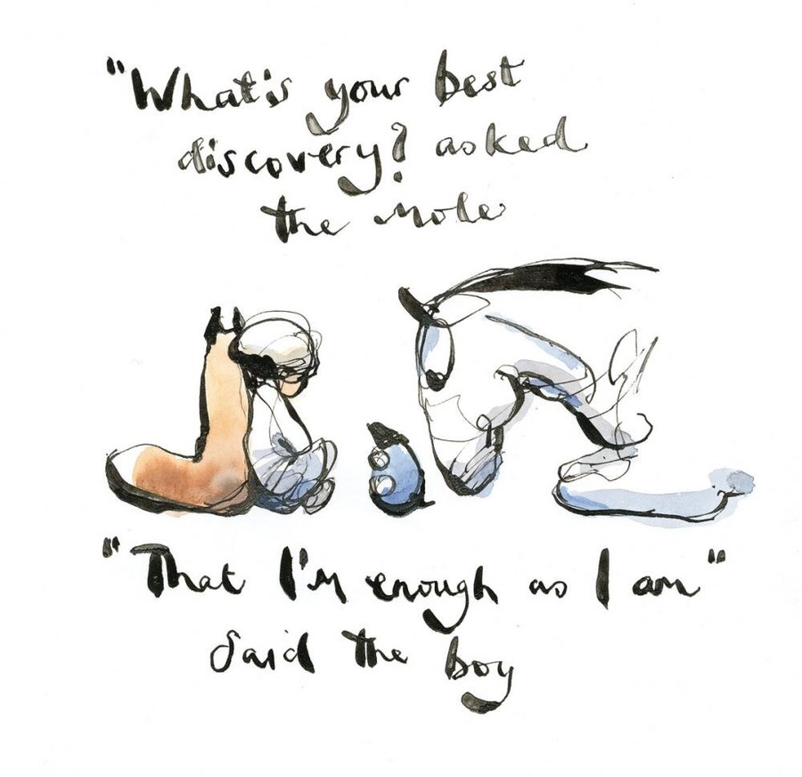

Slide 6
“Between stimulus and response there is a space. In that space is our power to choose our response. In our response lies our growth and our freedom. “ Viktor E. Frankl

Slide 7
Sea of Reactivity

Slide 9
3 Step Breathing Space
Step 1
Ask yourself, how am I doing just right now? What am I noticing? Perhaps naming any emotions i.e. ‘anger is here right now’
Step 2
Bring your attention to the experience of the in-breathe and out-breath. Just breathing. Perhaps counting the in-breath.
Step 3
Expanding our awareness to include the whole body, and the space around the body. Deepening our breath to create space, breathing into any tension and softening on the outbreath.

Slide 10
Anxiety is a feeling of unease, such as worry or fear, that can be mild or severe.
Everyone has feelings of anxiety at some point in their life.
It can spur us on, help us stay alert, make us aware of risks and motivate us to solve problems.
Repeated exposure to what we fear weakens anxiety, whilst building resources and resilience.
What is anxiety?

Slide 11
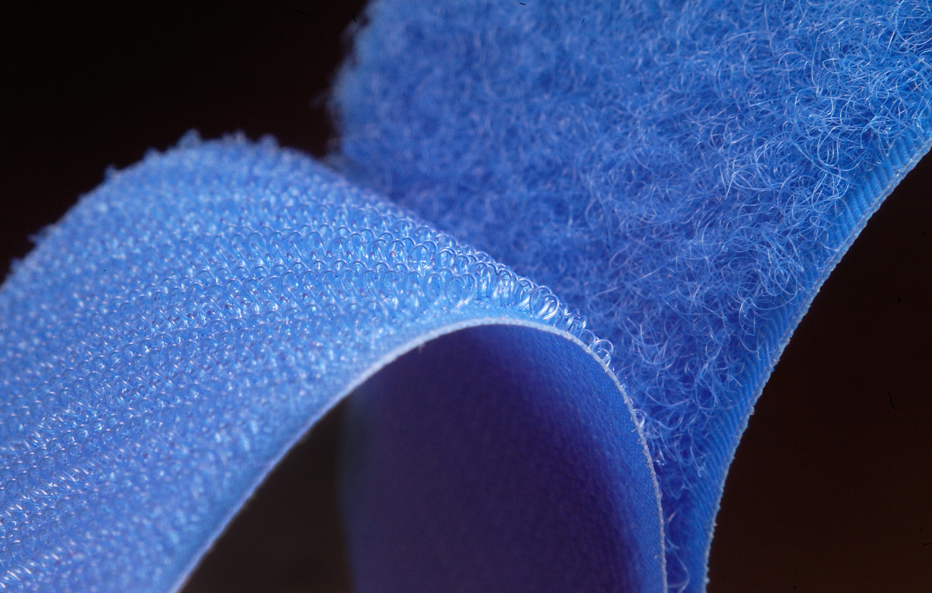
The Negative Brain Bias
Studies have shown that:
In a relationship, it typically takes five good interactions to make up for a single bad one.
Painful experiences are much more memorable than pleasurable ones.
Cause of rumination
The brain is like
Velcro for negative experiences
But Teflon for positive ones

Slide 12
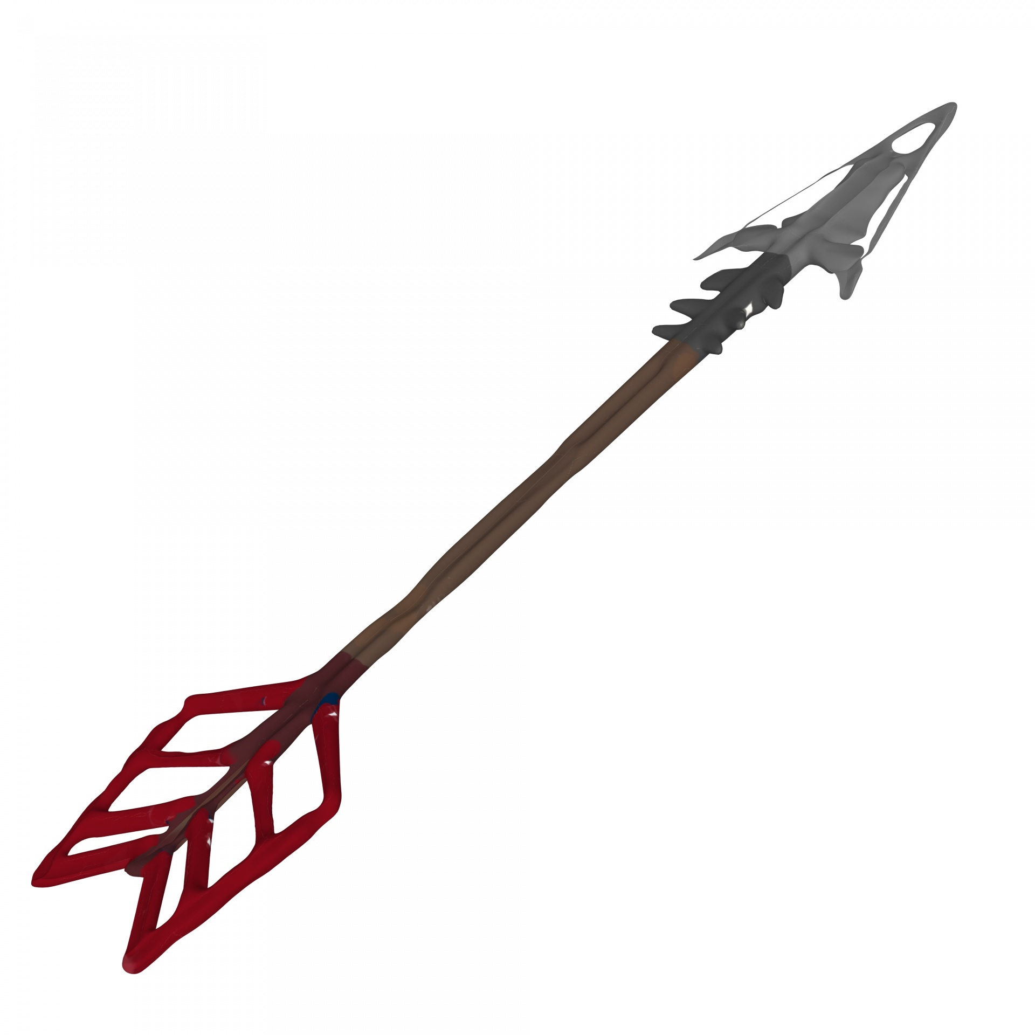
The Two Arrows of Suffering
We often don’t get what we want.
All too often we instead get what we don’t want.
Even when we do get we want,
it’s impossible to hold onto it forever.
‘Pain is inevitable. But suffering is optional’

Slide 13
Let your kids take risks
Pay attention to your own reactivity, how much is about you and your fears, not theirs?
Let your kids make mistakes so they can learn how to manage these situations and develop coping skills
Be helpful by assisting your child to manage their own situation, BUT have child solve it themselves so they learn
They just need to be listened to, to feel felt and understood
Being able to hold them in their emotional distress without trying to fix
What can we do?

Slide 14
“As a single footstep will not make a path on the earth, so a single thought will not make a pathway in the mind. To make a deep physical path, we walk again and again. To make a deep mental path, we must think over and over the kind of thoughts we wish to dominate our lives.”
Henry David Thoreau, 1854

Slide 15
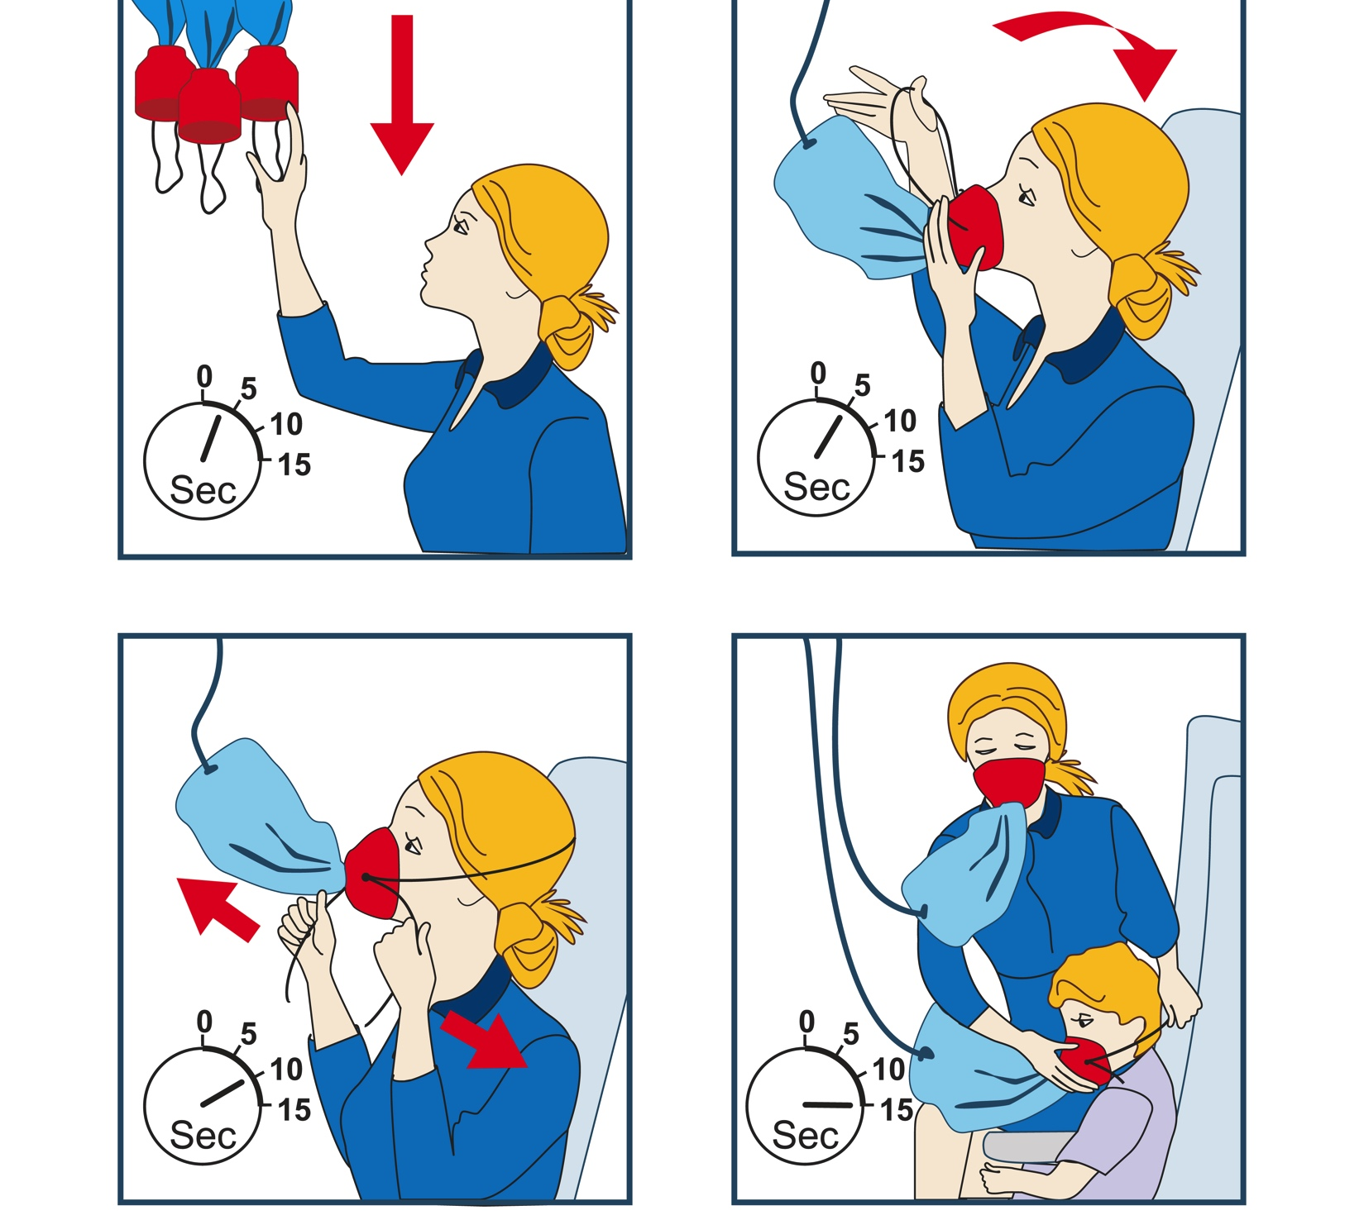
Oxygen Mask Principle
"Taking good care of yourself means the people in your life receive the best of you, rather than what is left of you."
Lucille Zimmerman

Slide 16
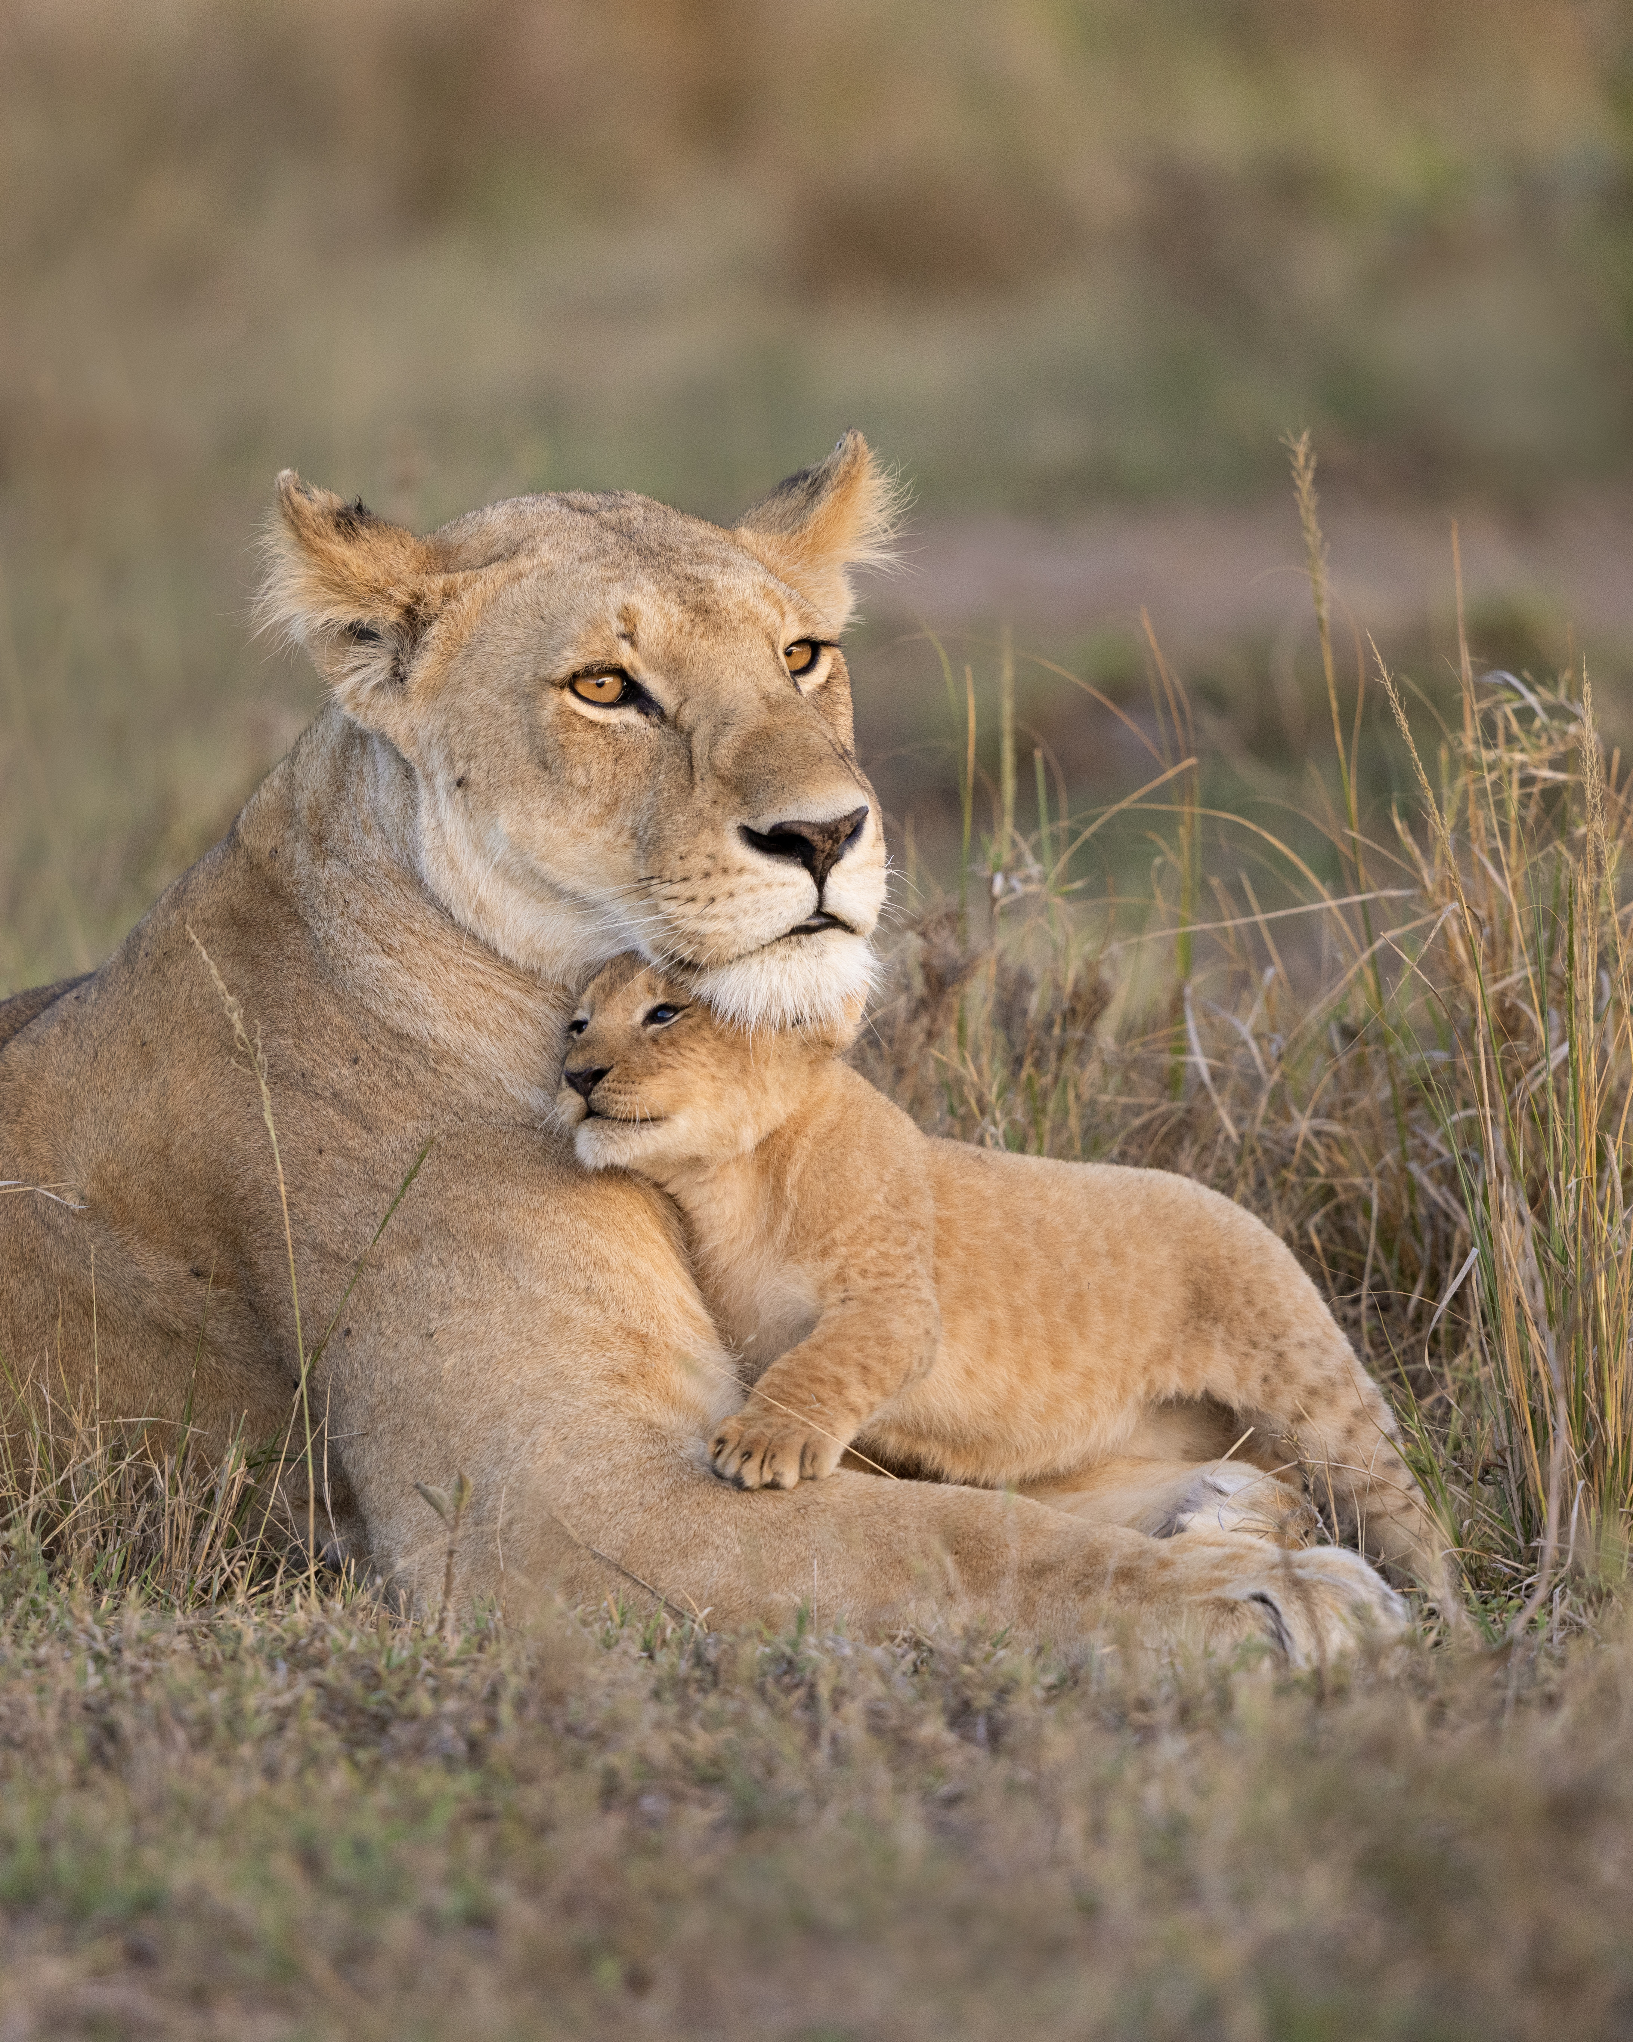
The Secret Power of your Stable Nervous System
Co-regulating species of mammals
Our nervous system is the intervention
Dysregulated = rational thinking gone

Slide 17
S.T.O.P Practice
S = Stop, Pause (not ignoring)
Interrupt your ‘automatic pilot’ by concentrating on the present moment
T = Take a Breath/Moment
And bring your focus to the experience of the in-breathe and out-breath. Try taking some slightly deeper inhales and exhales to expand and create some space in your physical body.
O = Open to Observation
Connect to the experience of this moment and inquire with a sense of curiosity:
What am I seeing? Smelling? Tasting? Feeling? Hearing? Thinking?
P = Proceed (possibilities, play, problem solving)

Slide 18
“Accept your feelings, even the ones you wish you did not have. Accept your experiences, even the ones you hate. Don’t condemn yourself for having human flaws and failings. Learn to see all the phenomena in the mind as being perfectly natural and understandable. Be kind to yourself. You may not be perfect, but you are all you’ve got to work with.”
H. V. Gunaratana

Slide 19
Mindful Listening
"We spend most of our moments when someone is speaking, planning what we’re going to say, evaluating it, trying to come up with our presentation of our self, or controlling the situation. Pure listening is a letting go of control. It’s not easy and takes training… The bottom line is when we are listened to, we feel connected. When we’re not listened to, we feel separate."
Tara Brach: The Sacred Art of Listening

Slide 20
“May I be granted the serenity to accept the things I cannot change, courage to change the things I can, and wisdom to know the difference”
Reinhold Niebuhr

Slide 21
Things to try
3-Step Breathing Space
S.T.O.P practice – spotlight on senses
Daily routine activity – know what you are doing whilst you are doing it!
Tune in to points of physical contact –
soften body
Name it!
Spend time in nature: 5,4,3,2,1
Practice gratitude
Be curious!

Slide 22
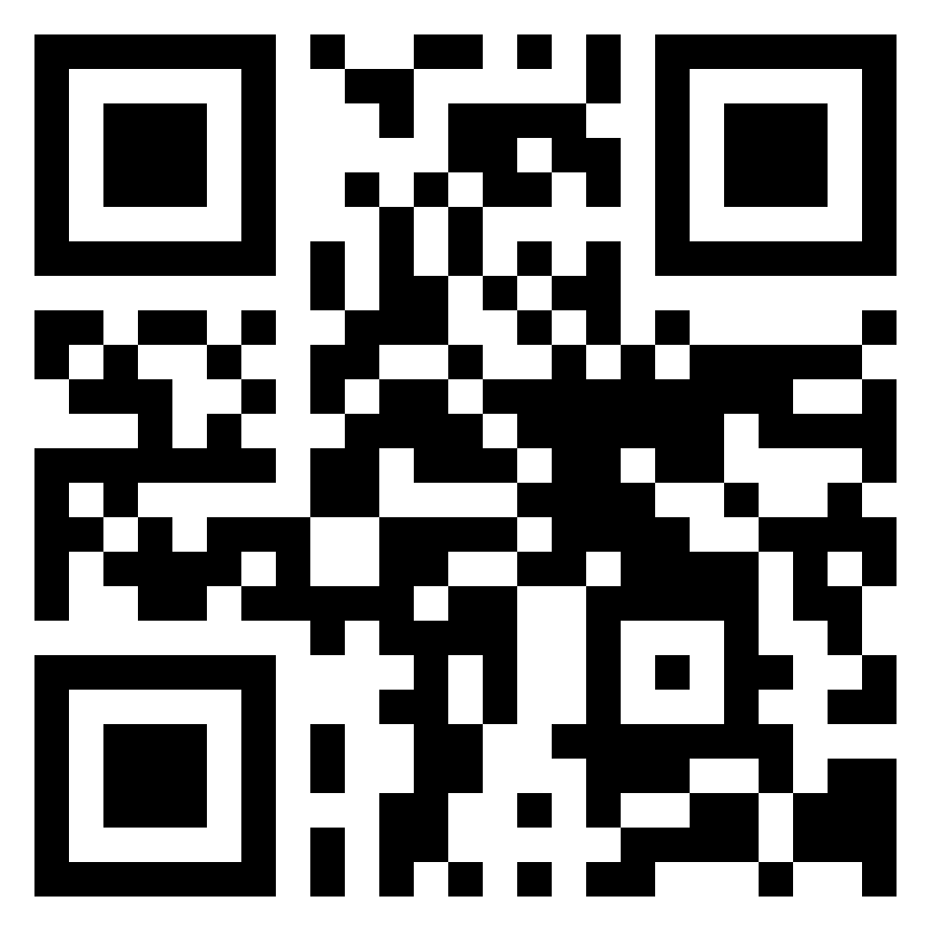
Any Questions?
Socials: The Breathe Academy
T: 07970 067197
www.thebreatheacademy.co.uk

